Slide 1

HR Knowledge (EPF/2018/001)
D
E
L
H
I
GURGAON
NO
I
D
A
E-nomination Facility on EPFO Unified Member Portal
HR Solutions

Slide 2

E-nomination Facility by EPFO on Unified Member Portal
Disclaimer:
Workforce Consulting, make no warranty of any kind with respect to the subject matter included herein or the completeness or accuracy of information contained in the website/email/PPT . Workforce Consulting is not responsible for any actions (or lack thereof) taken as a result of relying on or in any way using information contained in this website/email/PPT and in no event shall be liable for any damages resulting from reliance on or use of this information. Without limiting the above Workforce Consulting have no responsibility for any act or omission of any other contributor. Readers should take specific advice from a qualified professional when dealing with specific situations .This website/email/PPT may contain technical inaccuracies and changes to the information contained herein may be made at any time.
HR Solutions

Slide 3
E-nomination Facility by EPFO on Unified Member Portal
EPFO has recently launched facility of E-nomination on Unified Member Portal. EPFO subscriber can give nomination or change existing nomination by using this facility. EPF subscriber should use this facility to check and change your EPF account nomination. In this ppt, you will find the step by step process of using E-nomination facility.
The earlier process of changing EPF nomination offline was lengthy and cumbersome. In an old offline process, EPF subscriber was submitting FORM 2 for the nomination. This form was submitted to an employer for authorization. An employer was sending this Form to EPF office for nomination change. The entire process was manual and time-consuming.
HR Solutions

Slide 4
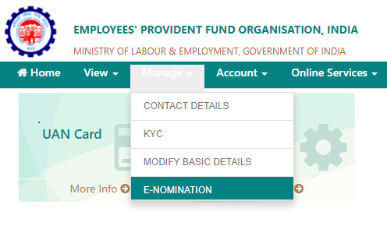
Steps of using E-nomination facility – Unified Member Portal
Step 1 – Visit Unified Member Portal –
  https://unifiedportal-mem.epfindia.gov.in/memberinterface/
  and login using UAN credential. In the Manage tab, you will find menu ‘E-nomination’.
HR Solutions

Slide 5
Step 2 – Click on E-nomination and you will be taken to the Profile Page. Profile page shows your UAN number, Name, date of birth and gender. You need to enter your Permanent Address in the provided box and click on save button.
  It will update your address. In order to complete this process, your Date of Joining EPF Scheme must be registered with EPF account. In case it is not defined it will not allow you to save address and update nomination.
Step 3 – Once you press save button it will update your profile details and prompt you by asking family declaration.
HR Solutions

Slide 6
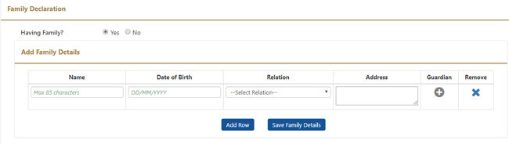
Step 4 – On selecting Having Family – Yes, you will be asked to input your family details. Enter Name, date of birth and address. Select a relationship from a drop down menu Relation. Once you are done with the process click on “Save Family Details” button.
HR Solutions

Slide 7
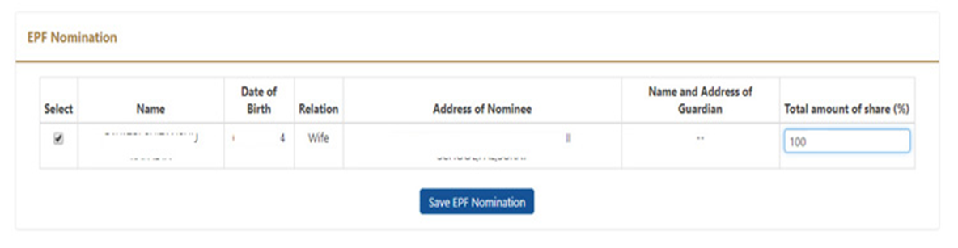
Step 5 – Next page is of EPF Nomination. In this page, you need to select your family member and provide input for Total Amount of Share %.
HR Solutions

Slide 8
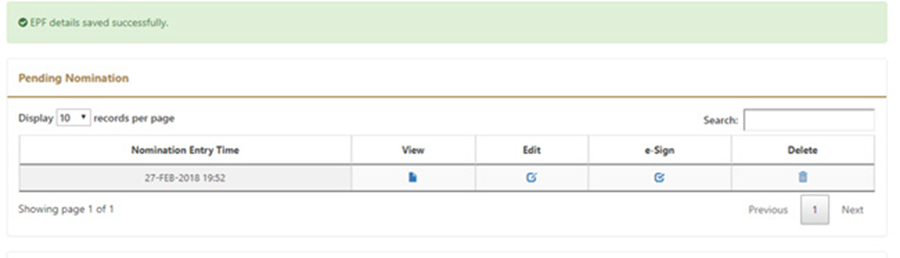
Step 6 – Once you are done press Save EPF Nomination button. It will save EPF details in your account.
Step 7 – Next step is approving nomination by using e-sign. You need to click on e-sign button.
HR Solutions

Slide 9
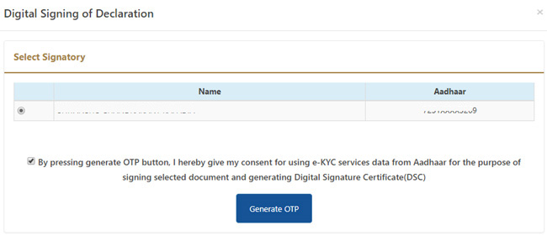
Step 8 – It will open popup window asking to select signatory and generate OTP button. You need to click on Generate OTP button. It will send OTP to your Aadhaar registered mobile number.
You do not require any additional Digital Signature Certificate. Your OTP consent is enough for signing a document and generating Digital Signature Certificate.
After entering OTP your nomination will be registered in your EPF account.
HR Solutions

Slide 10
Workforce Consulting – Our Services
With a formidable reputation in Indian Labour Law Compliances and comprehensive Payroll Process Outsourcing, Workforce Consulting offers a range of consulting services to an extensive national client base.
Think Compliance, Think Workforce!
HR Managed Services
HR Delivery Services
Payroll Outsourcing
Labour Law Compliance
HR Solutions

Slide 11
Workforce Consulting – Contact Us
Think Compliance, Think Workforce!
Empowered by Clients Satisfaction…
  Workforce Consulting
  307, Puja House
  Karampura Commercial Complex
  Shivaji Marg, New Delhi 110015 (INDIA)
  Web site: www.wokforce.org.in
  Email : info@workforce.org.in
  helpdesk@workforce.org.in
  Land line: +91-11-40115995
  Mobile: +91-8860 3939 60
HR Solutions

Slide 12
Thank you
HR Solutions

